Slide 1
BOOTSTARP
CASCADING STYLE SHEET
BOOTSRAP IS FRAMEWORK

Slide 2
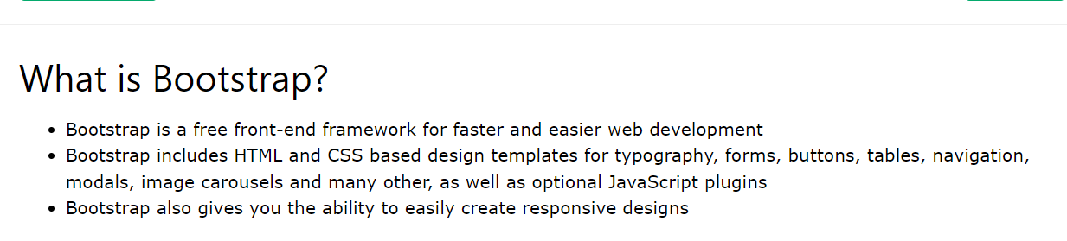
Bootsrap integration

Slide 3
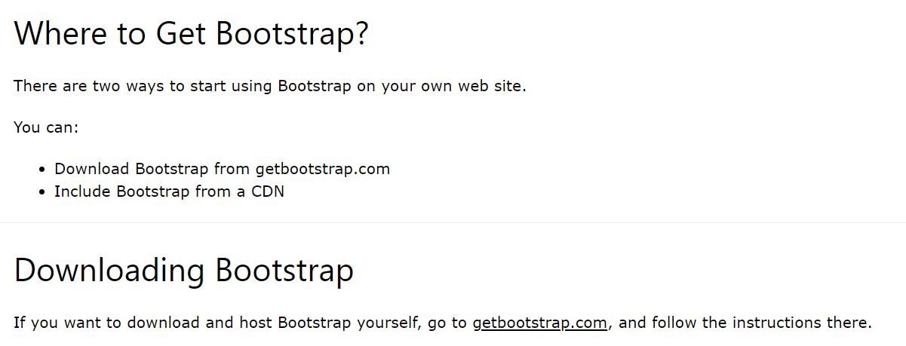
CONTINE......

Slide 4
CONTINE....
<!-- Latest compiled and minified CSS -->
<link rel="stylesheet" href="https://maxcdn.bootstrapcdn.com/bootstrap/3.4.1/css/bootstrap.min.css">
OR <link href="https://cdn.jsdelivr.net/npm/bootstrap@5.3.3/dist/css/bootstrap.min.css" rel="stylesheet"> or <link rel="stylesheet" href="https://maxcdn.bootstrapcdn.com/bootstrap/3.4.1/css/bootstrap.min.css">

Slide 5
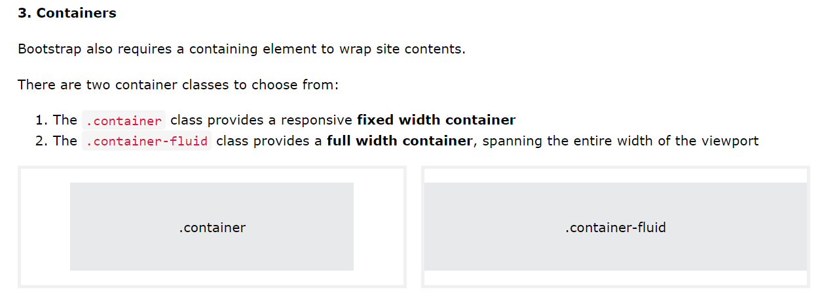
Contine......

Slide 6
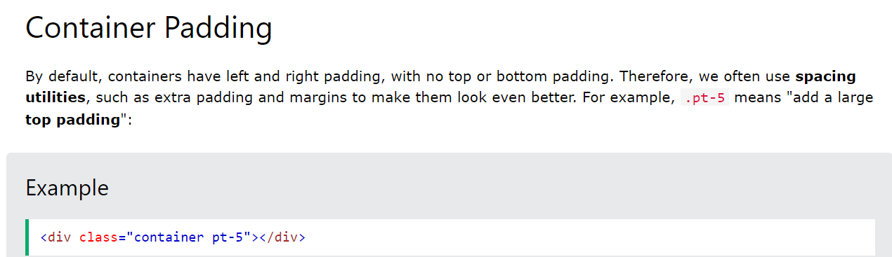
Contine..

Slide 7
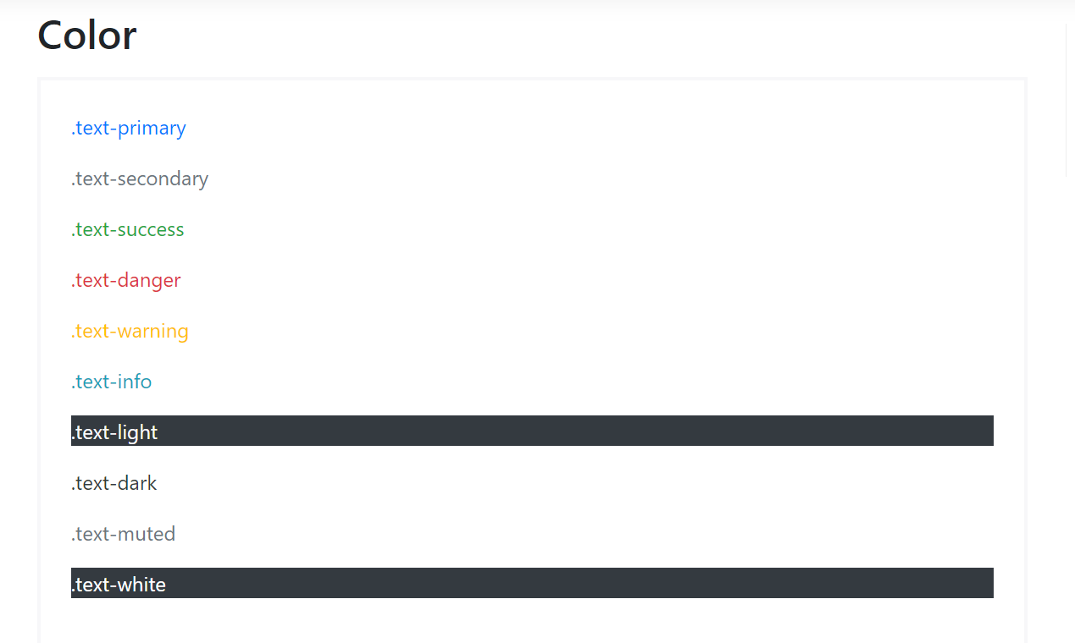
Colors in Bootstarp

Slide 8
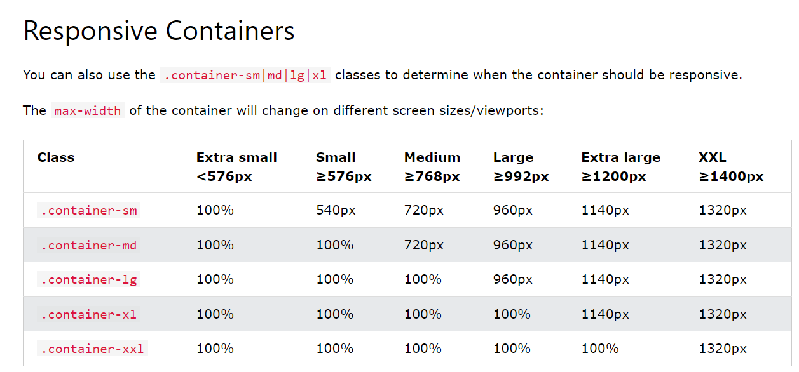
Responsive Containers

Slide 9
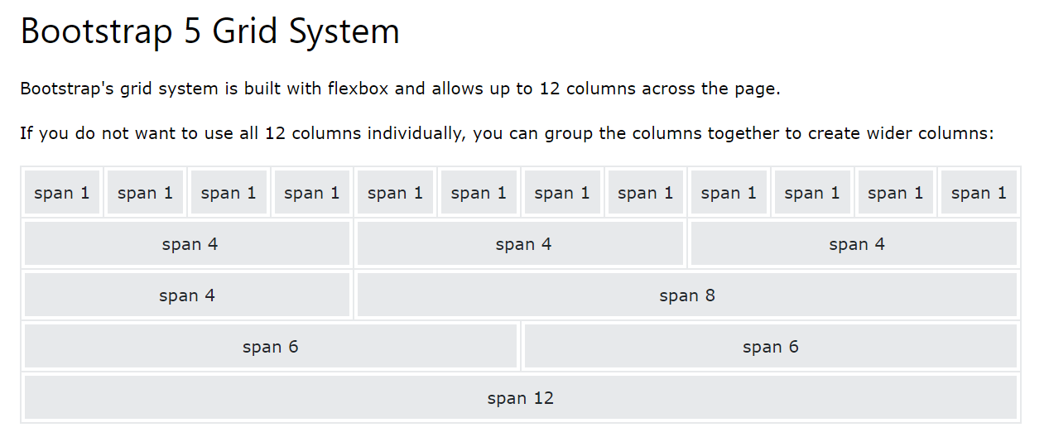
Contine....

Slide 10
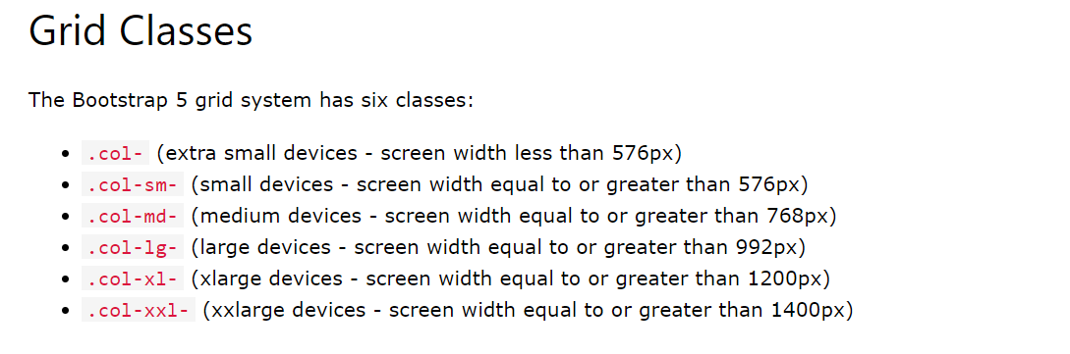
Contin....

Slide 11
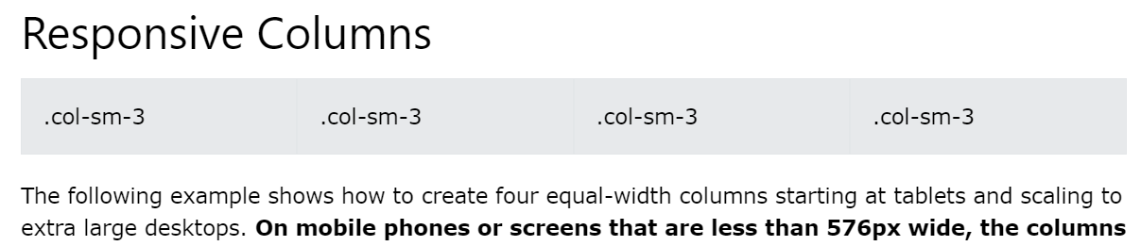
Contine...

Slide 12
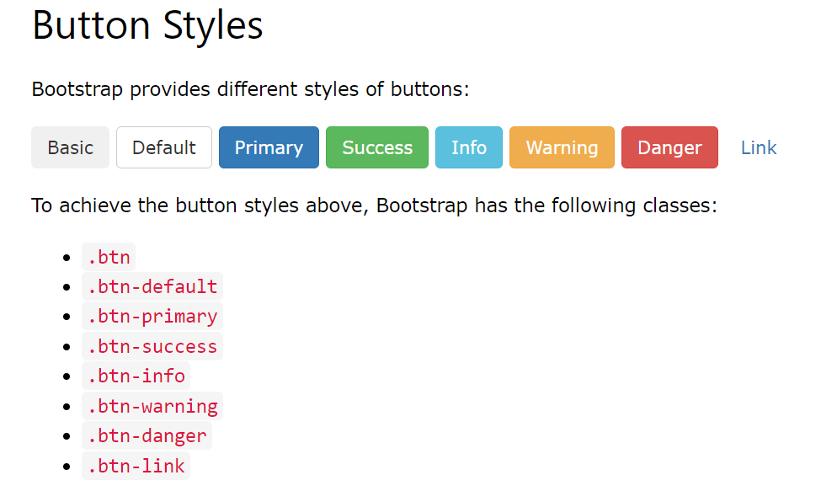
Bootstrap Buttons

Slide 13
EXTENSION FOR USE ICONS
https://fontawesome.com/v4/icons/ <link rel="stylesheet" href="https://cdnjs.cloudflare.com/ajax/libs/font-awesome/4.7.0/css/font-awesome.min.css">

